Slide 1
Lambda Architecture
Lecturer: Ngo Huy Bien
Software Engineering Department
Faculty of Information Technology
VNUHCM - University of Science
Ho Chi Minh City, Vietnam
nhbien@fit.hcmus.edu.vn

Slide 2

Objectives

Slide 3

Contents
Lambda Architecture
Realtime Views
Examples

Slide 4

References
Nathan Marz and James Warren (2015). Big Data - Principles and Best Practices of Scalable Realtime Data Systems. Manning Publications.

Slide 5
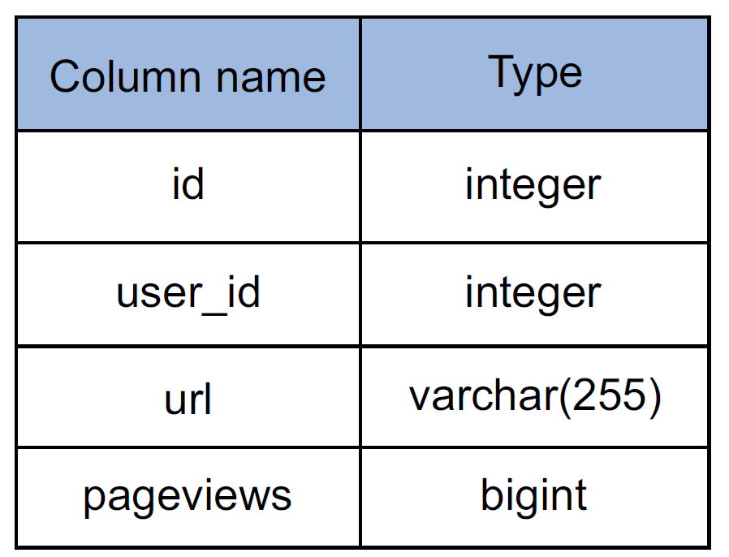
Simple Analytics Application [1]
The application should track the number of pageviews for any URL a customer wishes to track.
The customer’s web page pings the application’s web server with its URL every time a pageview is received.
The application should be able to tell you at any point what the top 100 URLs are by number of pageviews.
Timeout error on inserting to the database.
Relational schema for simple analytics application

Slide 6
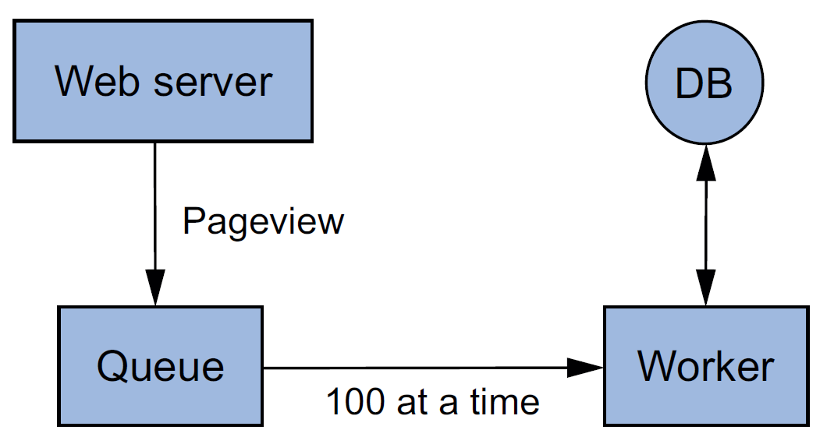
Scaling with a Queue
Instead of having the web server hit the database directly, you insert a queue between the web server and the database.
Whenever you receive a new pageview, that event is added to the queue.
You then create a worker process that reads 100 events at a time off the queue, and batches them into a single database update.
The database is clearly the bottleneck.
Batching updates with queue and worker

Slide 7
Scaling by Sharding the Database
Use multiple database servers and spread the table across all the servers.
Each server will have a subset of the data for the table.
As the application gets more and more popular, you keep having to reshard the database into more shards to keep up with the write load.
Batching updates with queue and worker

Slide 8
Corruption Issue
While working on the queue/worker code, you accidentally deploy a bug to production that increments the number of pageviews by two, instead of by one, for every URL.
You don’t notice until 24 hours later, but by then the damage is done.
The system is not engineered for human mistakes.

Slide 9
Fully Incremental Architecture Issue
Fully incremental architecture is architecture that makes use of read/write databases and maintains the state in those databases incrementally (e.g. pageviews column).
Lack of human-fault tolerance.

Slide 10
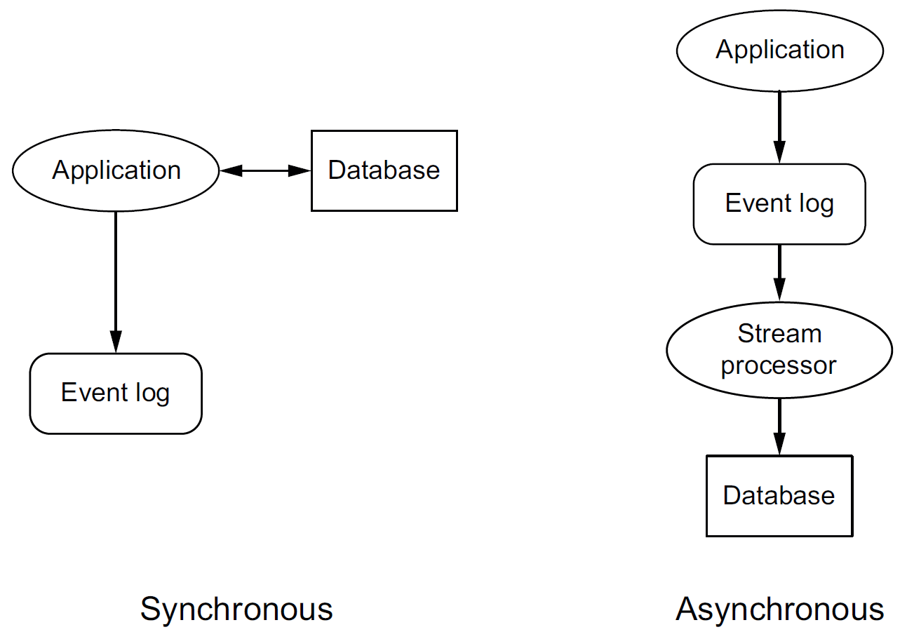
Event Log
Every event is permanently logged to an events datastore.
By keeping every event, if a human mistake causes database corruption, you can go back to the events store and reconstruct the proper state for the database.
Because the events store is immutable and constantly growing, redundant checks, like permissions, can be put in to make it highly unlikely for a mistake to trample over the events store.
Adding logging to
fully incremental architectures

Slide 11
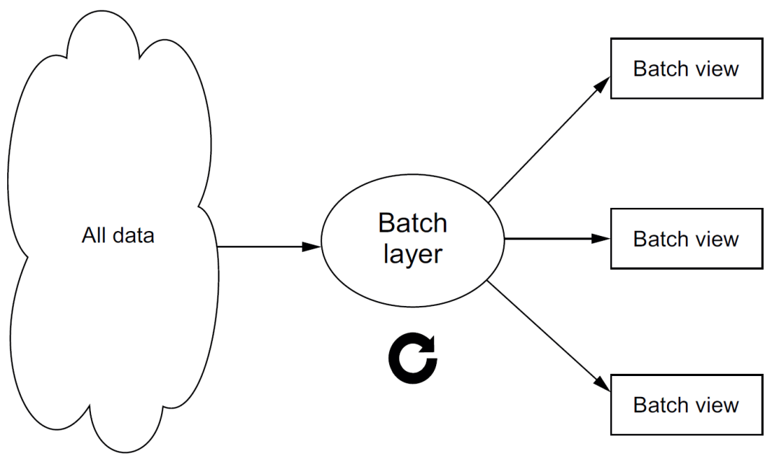
Batch Layer
Creating the batch view is clearly going to be a high-latency operation, because it’s running a function on all the data you have.
By the time it finishes, a lot of new data will have collected that’s not represented in the batch views, and the queries will be out of date by many hours.
batch view = function(all data)
query = function(batch view)
function runBatchLayer():
while(true):
recomputeBatchViews()

Slide 12
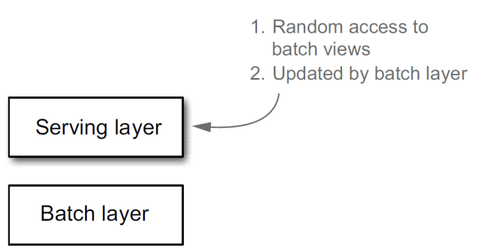
Serving Layer
The batch layer emits batch views as the result of its functions.
The next step is to load the views somewhere so that they can be queried.
A serving layer database supports batch updates and random reads.
Most notably, it doesn’t need to support random writes. This is a very important point, as random writes cause most of the complexity in databases. By not supporting random writes, these databases are extremely simple.

Slide 13
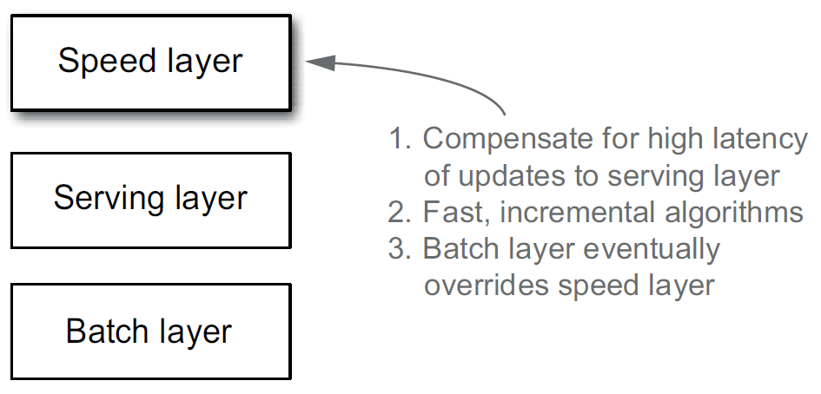
Speed Layer
The only data not represented in the batch view is the data that came in while the precomputation was running.
All that’s left to do to have a fully realtime data system—that is, to have arbitrary functions computed on arbitrary data in real time—is to compensate for those last few hours of data.
This is the purpose of the speed layer.
As its name suggests, its goal is to ensure new data is represented in query functions as quickly as needed for the application requirements.

Slide 14
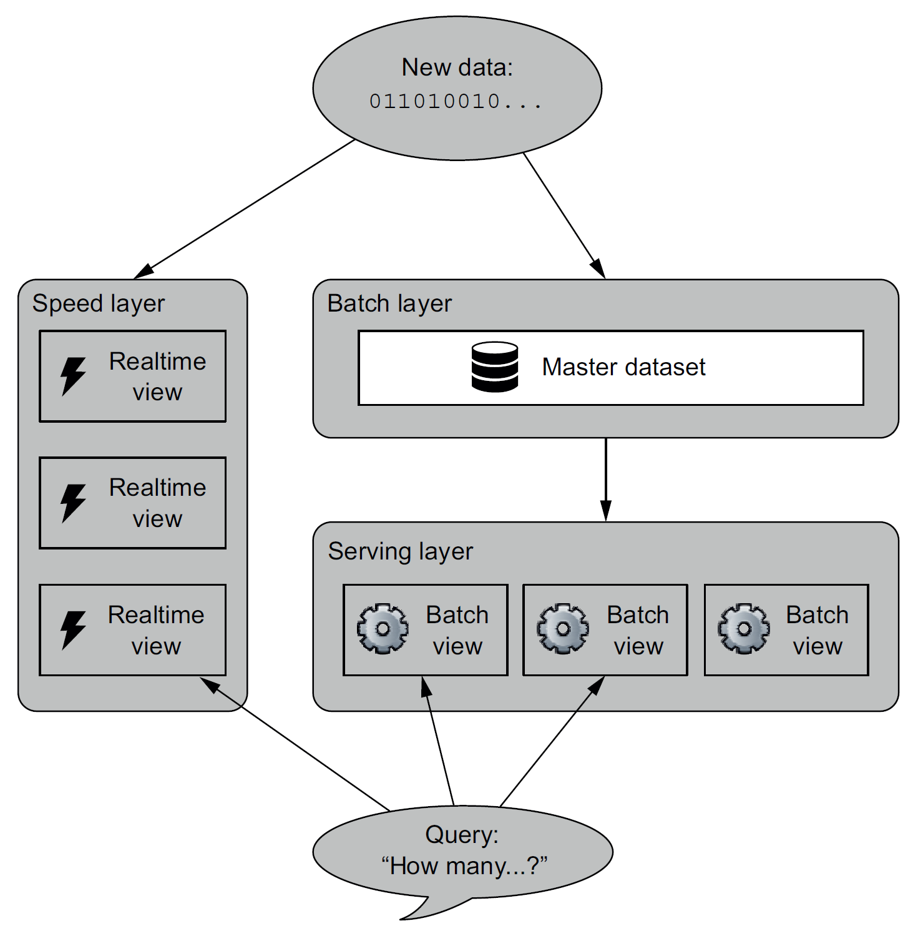
Lambda Architecture
batch view = function( all data )
realtime view = function( realtime view , new data )
query = function( batch view . realtime view )

Slide 15
Complexity Isolation
Once data makes it through the batch layer into the serving layer, the corresponding results in the realtime views are no longer needed. This means you can discard pieces of the realtime view as they’re no longer needed.
This is a wonderful result, because the speed layer is far more complex than the batch and serving layers.
This property of the Lambda Architecture is called complexity isolation, meaning that complexity is pushed into a layer whose results are only temporary.
If anything ever goes wrong, you can discard the state for the entire speed layer, and everything will be back to normal within a few hours.

Slide 16
Implementation Tools
Batch computation systems: Hadoop
Serialization frameworks provide tools and libraries for using objects between languages: Thrift, Protocol Buffers, and Avro.
Random-access NoSQL databases: Cassandra, HBase, MongoDB, Voldemort, Riak, CouchDB.
Messaging or queuing systems: Apache Kafka, RabbitMQ.
Realtime computation systems: Apache Storm.

Slide 17


Slide 18
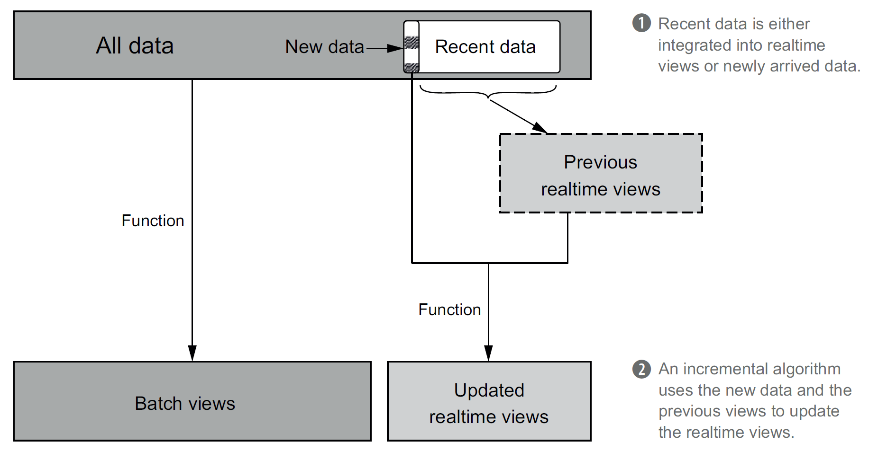
Computing Realtime Views
The idea is to update the realtime views as data comes in, thereby reusing the work that previously went into producing the views.
This requires the use of random-read/random-write databases so that updates can be performed on existing views.
realtime view = function( new data,
previous realtime view)

Slide 19
Storing Realtime Views
The obligations of the speed layer views are quite demanding—the Lambda Architecture requires low-latency random reads, and using incremental algorithms necessitates low-latency random updates.
These properties are common to a class of databases that have been dubbed NoSQL databases.
Examples: Cassandra
Realtime views are just realtime data that is processed and stored in databases.

Slide 20
Expiring Realtime Views
Because the simpler batch and serving layers continuously override the speed layer, the speed layer views only need to represent data yet to be processed by the batch computation workflow.
Once a batch computation run finishes, you can then discard a portion of the speed layer views—the parts now absorbed into the serving layer—but obviously you must keep verything else.

Slide 21
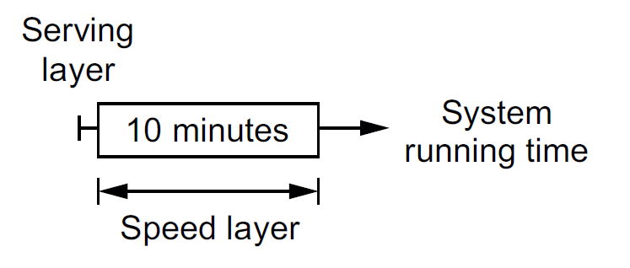
First 10 Minutes
After the first batch computation run, the serving layer remains empty but the speed layer has processed recent data.

Slide 22
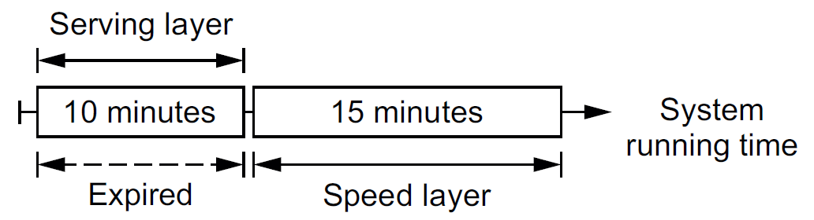
Next 15 Minutes
The second run of the batch layer immediately commences to process the 10 minutes of data that accumulated during the first run. For illustrative purposes, say the second run takes 15 minutes.
When it finishes, the serving layer views will represent the first 10 minutes of data, whereas the speed layer views will represent all 25 minutes of data.
The first 10 minutes can now be expired from the speed layer views.

Slide 23
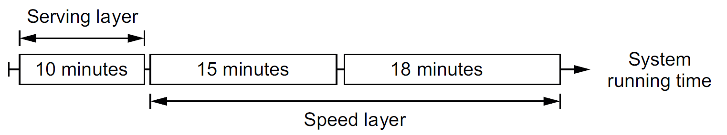
Next 18 Minutes
Finally, suppose the third run of the batch layer takes 18 minutes. Consider the instant before the third run completes.
At this point, the serving layer still only represents 10 minutes of data, leaving the speed layer to handle the remaining 33 minutes of data.
When a batch layer run finishes, data from three runs ago can safely be discarded from the speed layer.

Slide 24
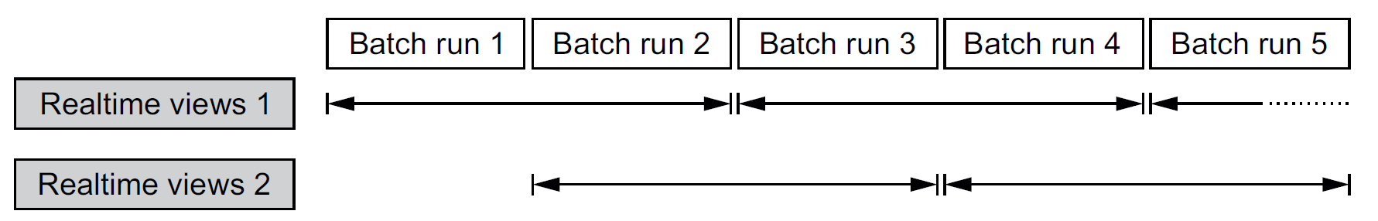
Two Sets of Realtime Views
The simplest way to accomplish this task is to maintain two sets of realtime views and alternate clearing them after each batch layer run.
One of those sets of realtime views will exactly represent the data necessary to compensate for the serving layer views.
After each batch layer run, the application should switch to reading from the realtime view with more data (and away from the one that was just cleared).
This is the key idea of Lambda Architecture.

Slide 26
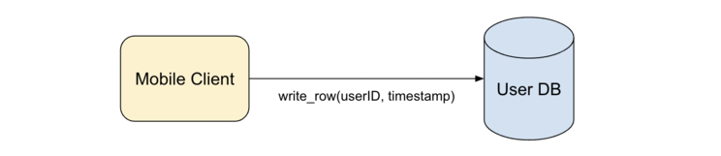
Example 1: Traditional Reporting
https://www.linkedin.com/pulse/lambda-architecture-practical-example-richard-sun
Daily User Counts
SELECT COUNT(DISTINCT player_id)
FROM player_table
WHERE DATE(`timestamp`) = DATE_SUB(CUR_DATE(), INTERVAL 1 DAY)

Slide 27
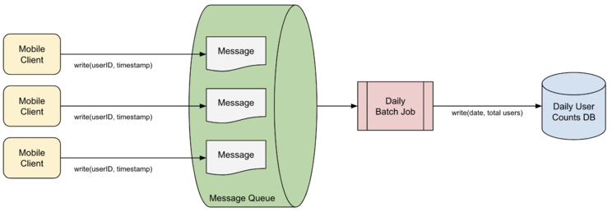
Example 1: Message Queue and Batch Layer
Write to a message queue instead, which can efficiently support a high number of write requests.
Introduce data retention by regularly purging stale data used already by previous daily jobs from the message queue.

Slide 28
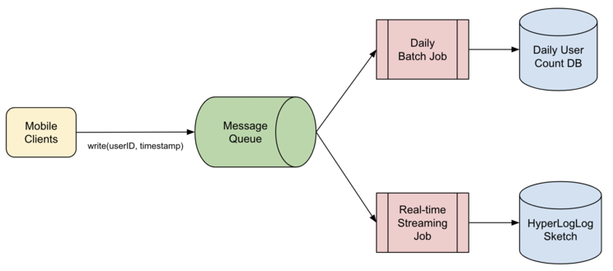
Example 1: Today Counts and Real-time Layer
We set up our streaming job, and add it as an additional consumer to our message queue where it constantly fetches the latest user IDs from the queue. The key idea is that this consumer serves only for today count. The important idea is cutover time.
Since Bob is fine with just a rough number in real-time, we decide to use a probabilistic cardinality counter, such as HyperLogLog which can approximate the number of uniques to a high degree of accuracy at a fraction of the memory footprint.

Slide 29
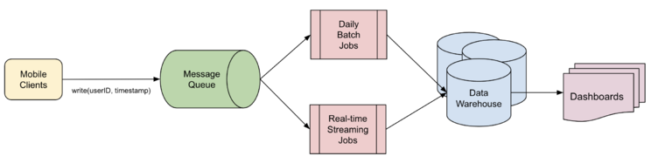
Example 1: Serving Layer
We join the different databases we have behind a single interface, and build tools and dashboards so the business team can visualize the data and run reports on an ad-hoc basis. The key idea is to use cutover time to merge data of different databases.

Slide 31
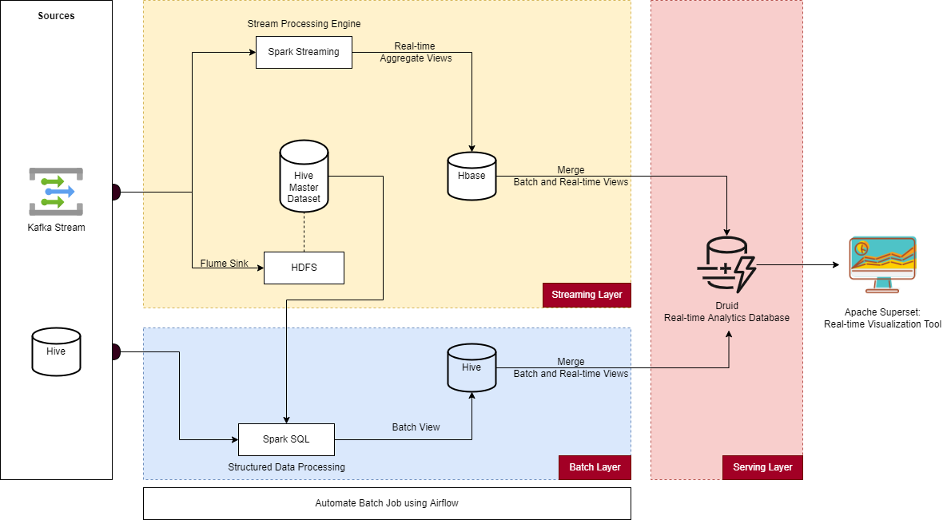
Example 2
https://www.linkedin.com/pulse/how-i-created-real-time-data-processing-pipeline-using-shergill

Slide 32
Example 2 Notes
Batch Layer uses Spark SQL API as a computation engine for processing all the data from Master Hive Dataset and Hive Table and creating a batch view which gets stored back to the Hive Table.
The stream processing engine I have used is Spark Structured Streaming. HBase is low latency NoSQL database which can handle random access writes optimal for storing real-time data.
I have used Apache Druid for joining Batch and Real-time views as this database is made for real-time data analytics applications. This enables us to run low latency SQL queries on top of various data sources which is perfect for my use case. I can query Hive source which stores my Batch views and HBase which stores my Real-time views.

Slide 34
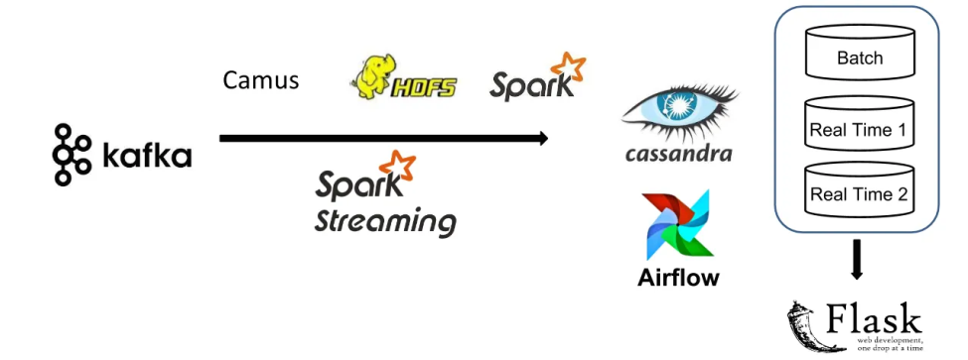
Example 3:
https://blog.insightdatascience.com/implementing-lambda-architecture-to-track-real-time-updates-f99f03e0c53
The key idea is to use three database tables: one that stores the result of the batch processing, one that stores only the trades made since the last batch processing run was finished, and one that stores the correct up to date values.
By using a separate database table to record only deltas, and having the full counts replaced by the results of the batch processing, any incorrect results caused by software, hardware or network problems will be resolved after a successful run of the batch processing, ensuring accurate results after each run.

Slide 36
Kappa Architecture
https://milinda.pathirage.org/kappa-architecture.com/
Kappa Architecture is a simplification of Lambda Architecture.
A Kappa Architecture system is like a Lambda Architecture system with the batch processing system removed.
To replace batch processing, data is simply fed through the streaming system quickly.

Slide 37
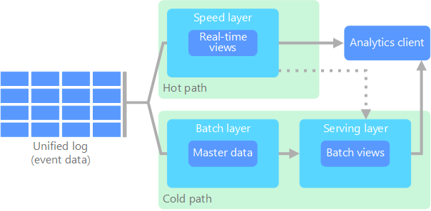
Lambda Architecture
https://learn.microsoft.com/en-us/azure/architecture/databases/guide/big-data-architectures

Slide 38
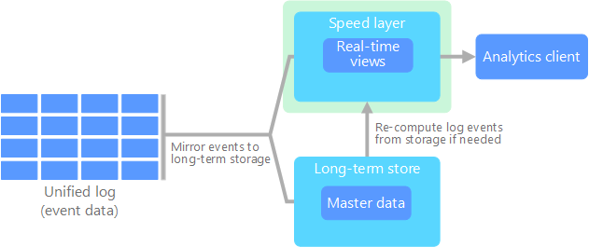
Kappa Architecture
https://learn.microsoft.com/en-us/azure/architecture/databases/guide/big-data-architectures

Slide 40
Apache Beam
https://beam.apache.org/get-started/beam-overview/
Apache Beam is an open source, unified model for defining both batch and streaming data-parallel processing pipelines.
Using one of the open source Beam SDKs, you build a program that defines the pipeline.
The pipeline is then executed by one of Beam’s supported distributed processing back-ends, which include Apache Flink, Apache Spark, and Google Cloud Dataflow.

Slide 41
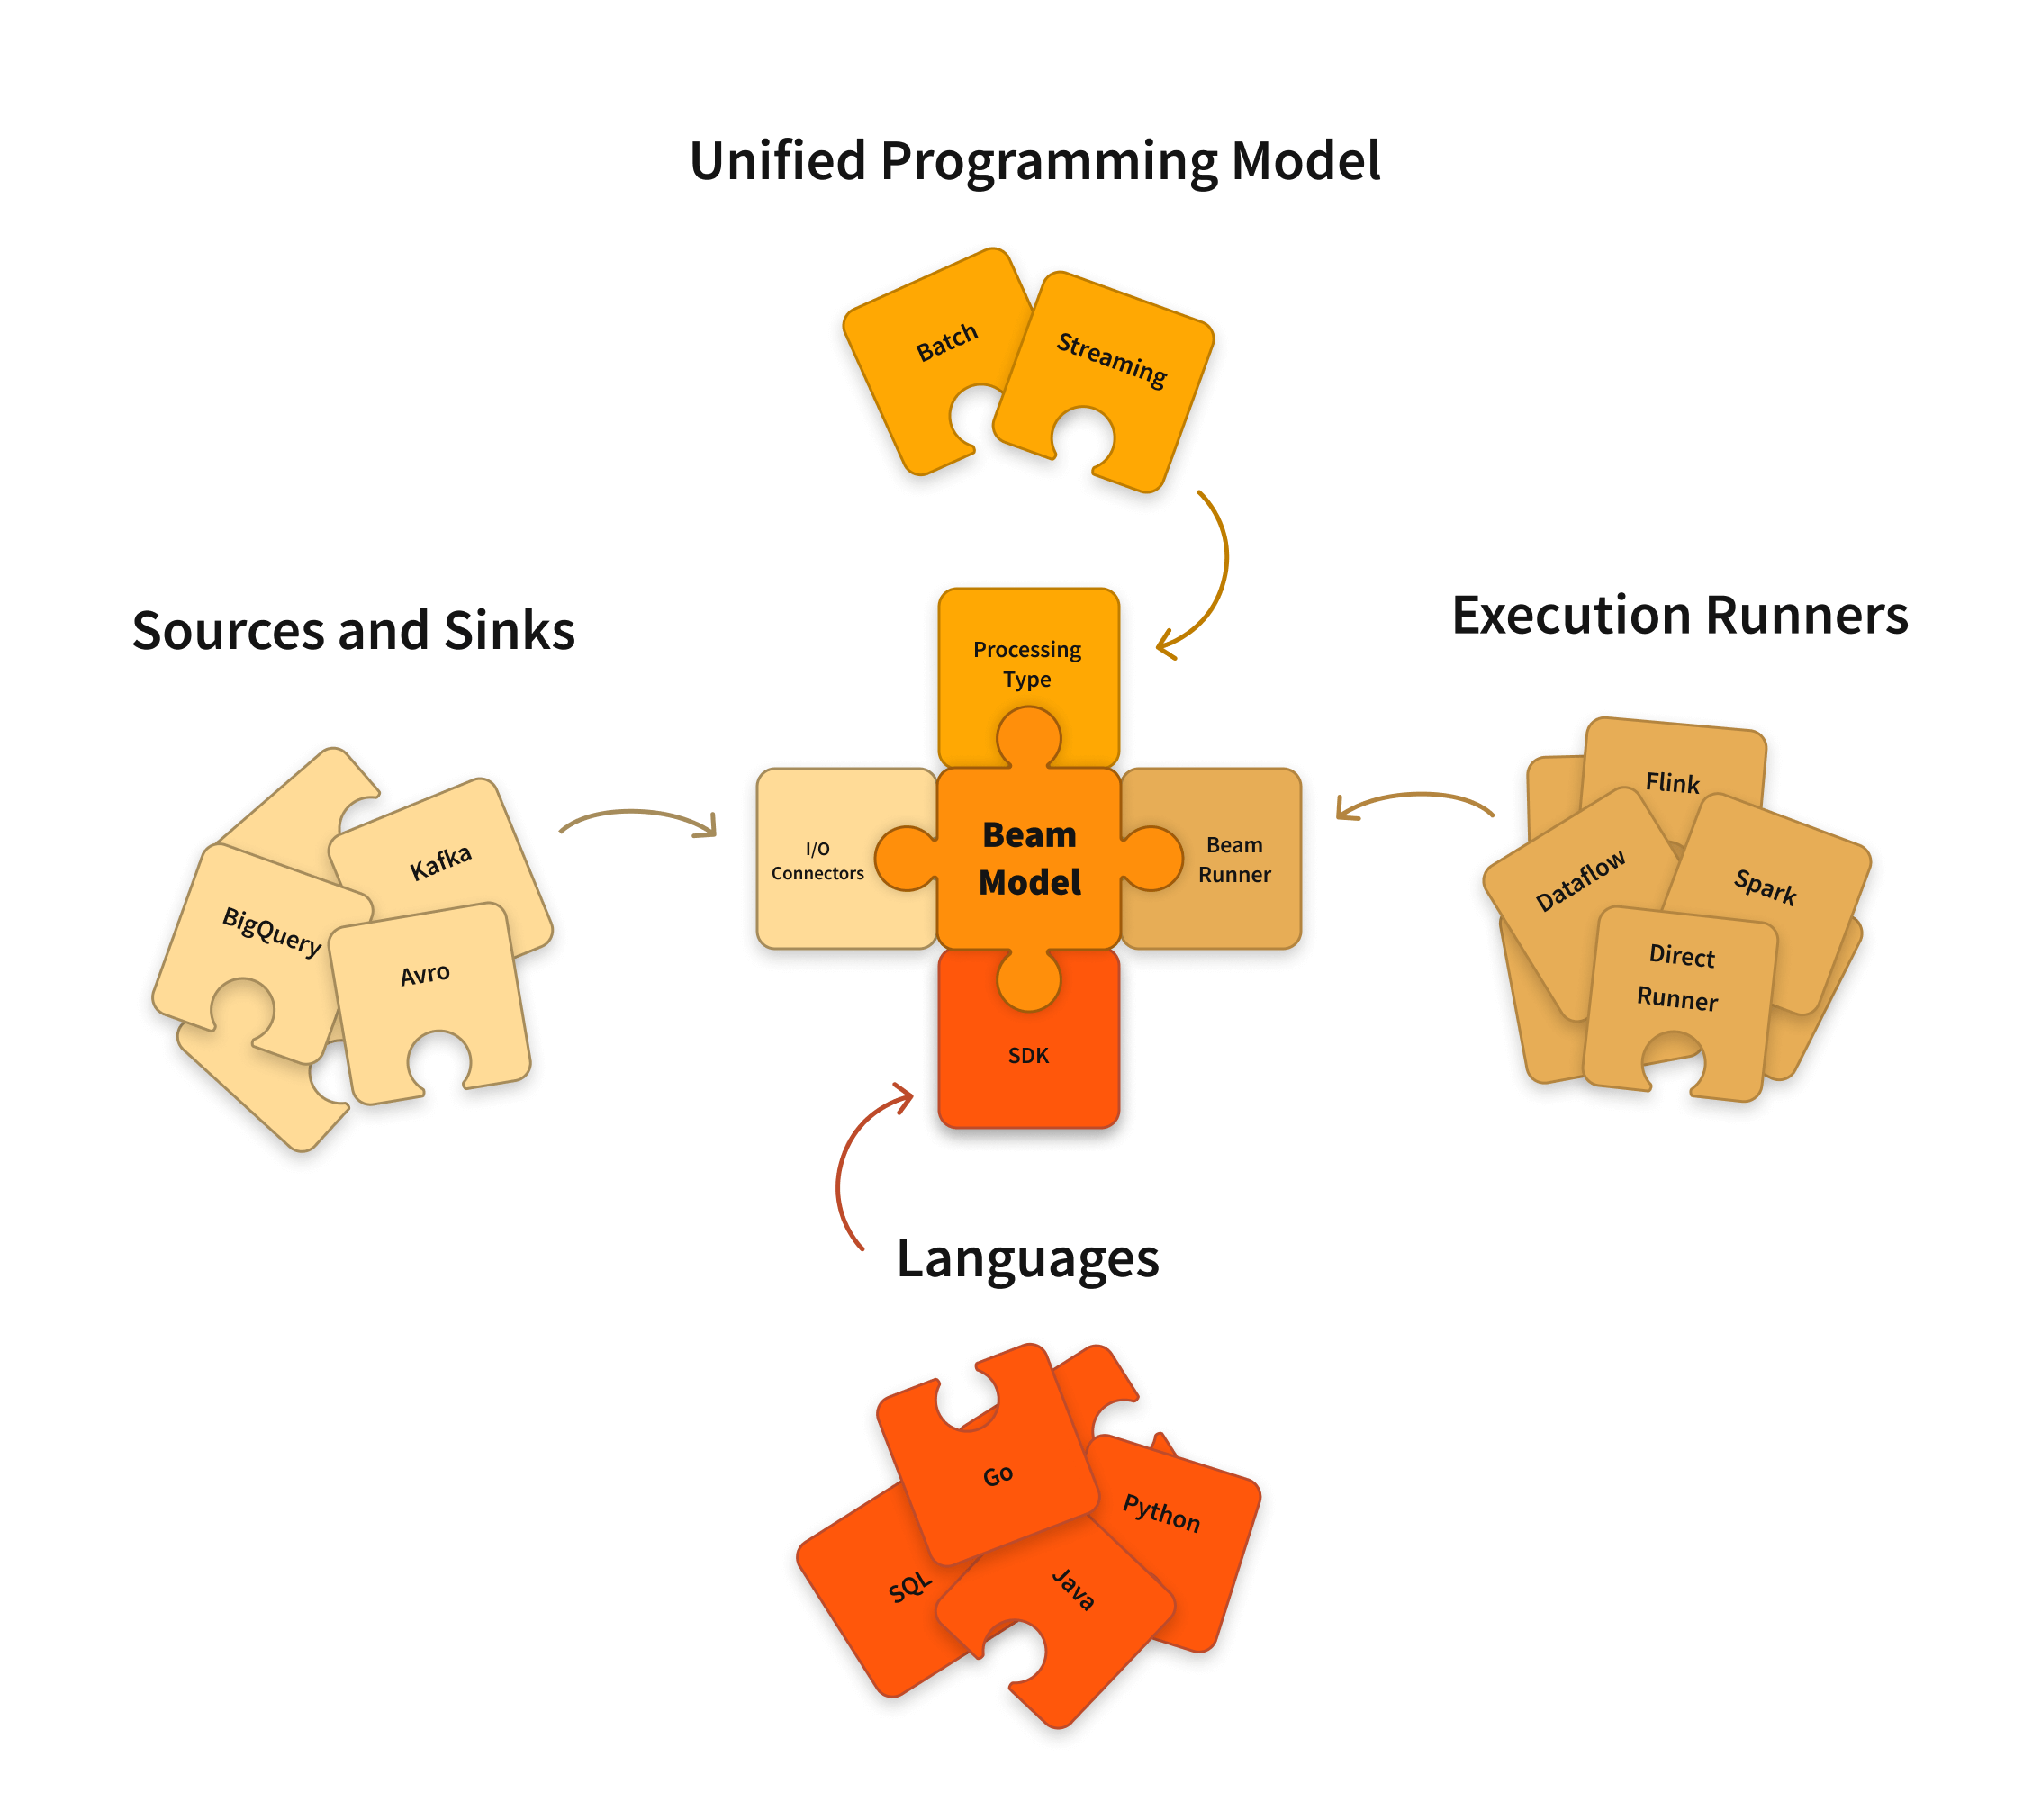
Apache Beam Overview

Slide 42
Apache Beam SDKs
Apache Beam Java SDK Java
Apache Beam Python SDK Python
Apache Beam Go SDK

Slide 43
Apache Beam Pipeline Runners
Direct Runner
Apache Flink Runner
Apache Nemo Runner
Apache Samza Runner
Apache Spark Runner
Google Cloud Dataflow Runner
Hazelcast Jet Runner
Twister2 Runner

Slide 44

Thank You & See You Again

